Slide 1

Solar Power Probabilistic Forecasting by Using Multiple Linear Regression Analysis
Badrul Chowdhury, Senior Member, IEEE, b.chowdhury@uncc.edu
Mohamed Abuella, Student Member, IEEE, mabuella@uncc.edu
Department of Electrical and Computer Engineering
Saturday, April 11, 2015

Slide 2
Forecasting Model Building
Model Results and Evaluation
Solar Energy Forecasting
Presentation Outline

Slide 3
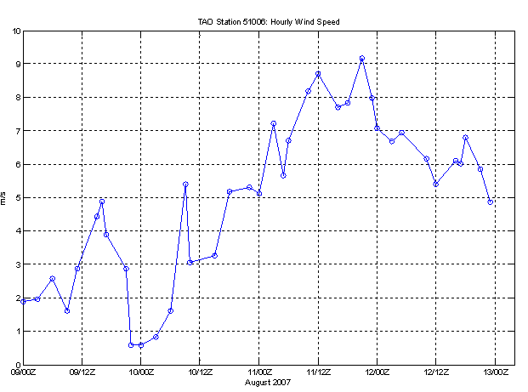




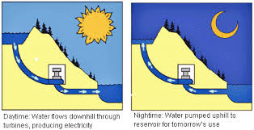
Solar Energy Forecasting
PG=PD + Ploss
Renewables Generations
(Wind and Solar) are Too Variable
High Efficiency and Large Energy Storage
Still not Exist
Reducing
Cost
and Pollution

Slide 4
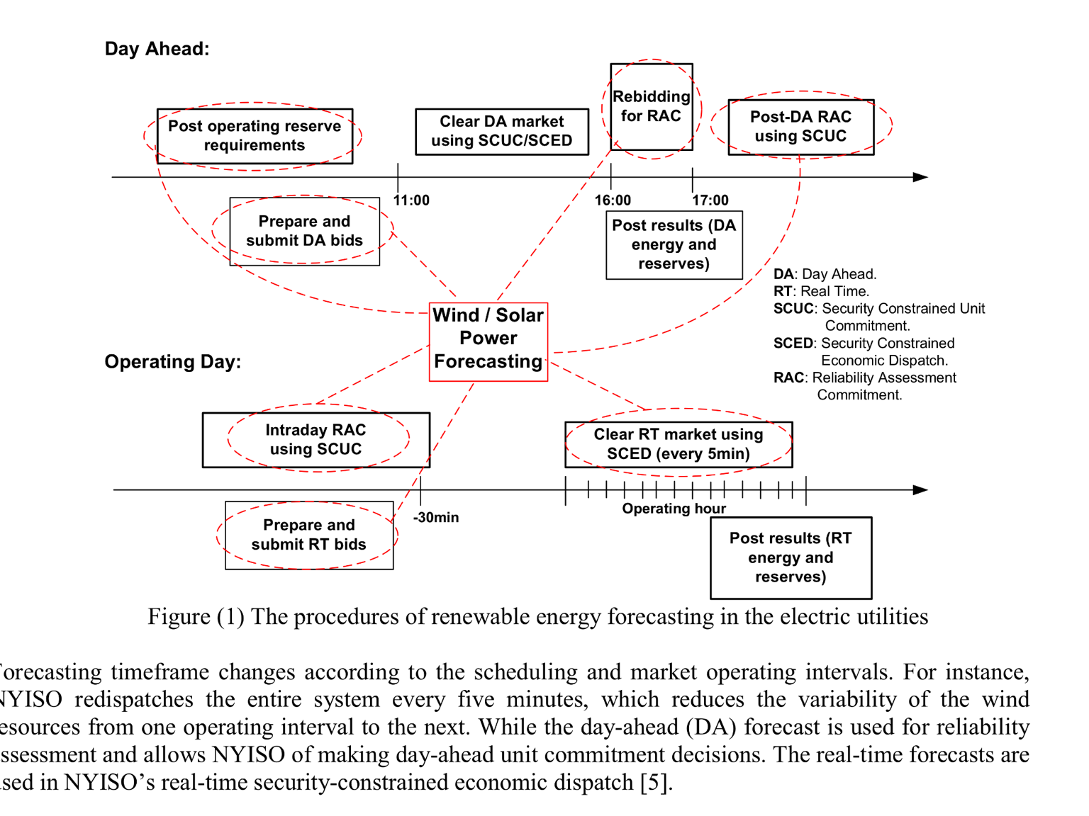

Solar Energy Forecasting
Where Forecast
In Electricity Markets Operation: You Plan What You Forecast

Slide 5
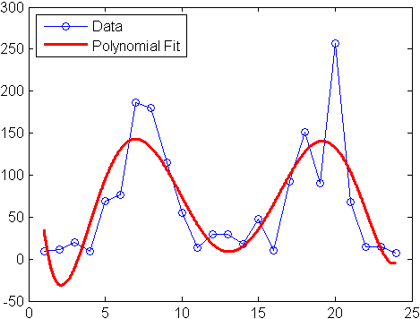
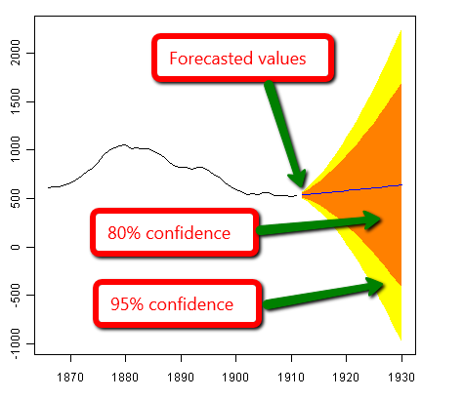
Forecasting
Model
Regression
Main Steps of forecasting Modeling
➔Training
➔Validation
➔Testing
Extrapolation
Statistical Approach Model

Slide 6
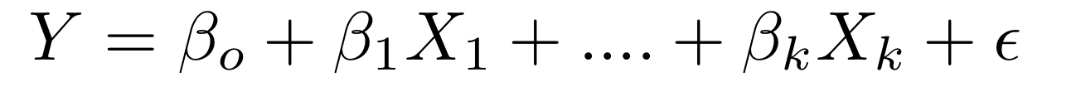
Forecasting
Model
The Model: Multiple Linear Regression (MLR) Analysis for Solar Power Probabilistic
Forecasts.
Benchmark Data
Building the Model in
Statistical Software
Outcome Forecasts
Data
Preparation
Adjusting
the output data
Flowchart of Solar Forecasting Modeling Stages

Slide 7
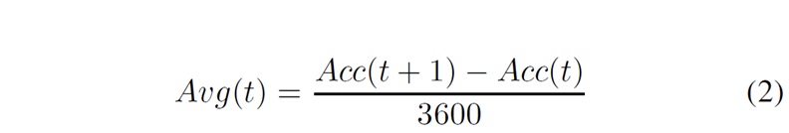
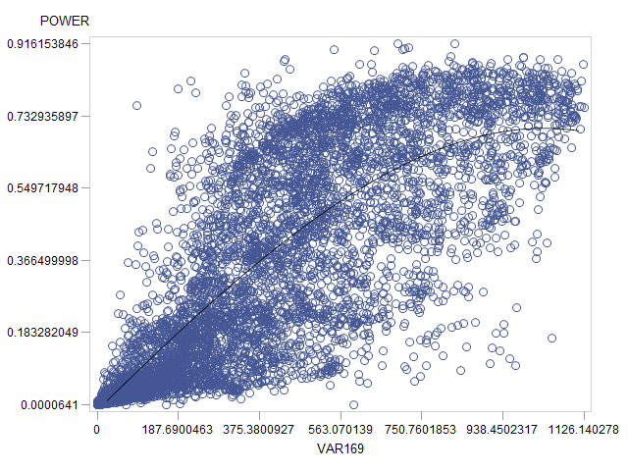
Forecasting
Model
Data Preparation
Benchmark Data
Cleansing the Data
Select most effective variable
Scatter & Box plots the Data
Correlation and Sensitivity Analysis
Flowchart of Data Preparation
Solar Power vs. Surface Solar Irradiance Down (SSRD)
169.128 (SSRD) J/m² Accumulated field Value (for all day hours)
169.128 (SSRD) W/m² Average Value (for each hour)

Slide 8
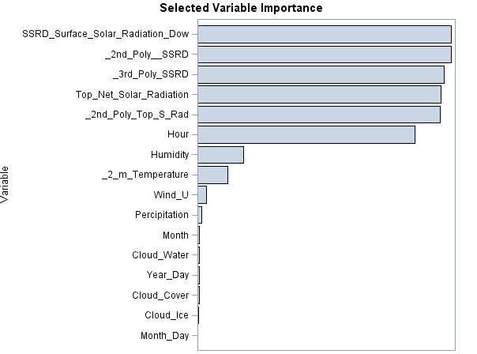
Forecasting
Model
Data Preparation
Benchmark Data
Cleansing the Data
Select most effective variable
Scatter & Box plots the Data
Correlation and Sensitivity Analysis
Flowchart of Data Preparation
The order of most effective variable for solar power forecast

Slide 9
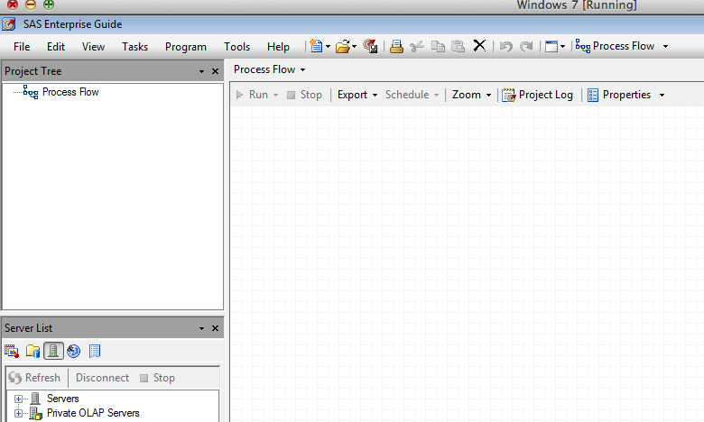
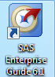
Forecasting
Model
ANOVA Method
Model Outcomes
(Solar Power Forecasts)
Multiple Linear Regression model
Quantitative,
Classification,
and Interaction
Variables Selection
Flowchart of Solar Forecasting Model Building Steps
The model has been built in SAS

Slide 10
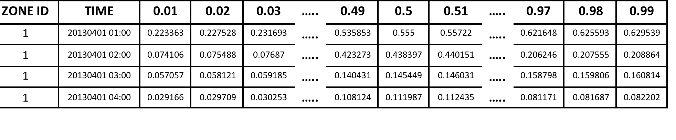
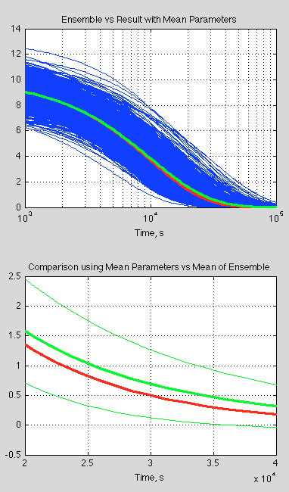
Model Results and Evaluation
Probabilistic Solar Forecasts Sample
Pinball Loss Function

Slide 11
Model Results and Evaluation
The line plots for actual solar power and the forecasts where q = 0.01, 0.5, 0.99

Slide 12
Model Results and Evaluation
The scatter plots for actual solar power and the forecasts where q = 0.01, 0.5, 0.99
q=0.50
q=0.99
q=0.01

Slide 13
Model Results and Evaluation
Actual Power
Predicted Power
Residuals
Scatter plot of the point forecasts vs. the actual solar power

Slide 14
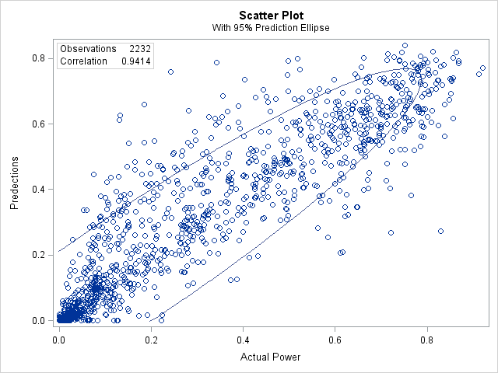
Model Results and Evaluation
Pearson correlation coefficient =0.9414

Slide 15
Conclusion
The multiple linear regression analysis model performed well for solar power forecasts.
If the forecasting hours were with clear sky, the model’s performance would be better for near forecasting horizon than farther horizon, but this is affected by cloudy hours, thereby the entire performance of the model.
Plotting the data, correlation and sensitivity analysis between the variables, as well as data cleansing of outliers are essential data preparation steps before building the forecasting model.
With additional historical data, the model performance will improve.

Slide 16
Thanks for Listening
Any Question?

